Slide 1
National Core Arts Standards
A Group Sharing and Discussion

Slide 2
A Common Attitude and Perception
Standards!.......
“We don’t need no stinkin’ standards!”
Or….. Do we?

Slide 3
Why do we have and/or need standards?
For better or worse, they are part of the national and state educational dialogue.
1994 National Standards, Goals 200
No Child Left Behind (NCLB) and the standards movement
Rigorous and quality education for all students
Testing and Measurement (NAEP, and other state and local assessments)
It is a professional expectation.
All content areas have them
Define and identify what knowledge and skills are valued and important; what students should know, be able to do, and what they should understand after a given period of time and instruction
Guides and influences an articulated curriculum that is multi-year and multi-level down to the state, district, and classroom level.

Slide 4
How does this impact us, here in New Mexico?
The current state standards are what are used to evaluate schools and districts in terms of the quality of instruction offered to students, through the Fine Arts Education Act (FAEA) funding application, and the End of Course (EOC) exam used to determine student growth for teacher evaluation purposes.
And as such, the state standards are a key document that drives what should be taught and assessed. If school districts have their own instructional standards, it is an expectation that they align with the New Mexico State Standards
However….
A big problem is that the current NM State Standards were developed in 1995-96, adopted in 1997 and are twenty years old....do not reflect current thinking in education, and are based on the 1994 National Standards.
There is movement at the NM PED to adopt the National Core Arts Standards to replace the current state standards. If this happens, the NCAS become “de rigueur” for music teachers in New Mexico.

Slide 5
Compare and Contrast
Old National/State Standards
Knowledge and Skills Based
Three Clustered Grade Bands: K-4 5-8 9-12
Paper Based
Different formats at national level among arts discipline.
Based on traditional instructional approaches and do not address alternative ensembles or current technologies.
Nine National C&A Standards/Benchmarks Eight State C&A Standards/Benchmarks
National Core Arts Standards
Fosters Understanding, Independence, and Artistic Literacy
Grades PreK-8, grade by grade 9-12 (High School) with three proficiency levels
Web-based, dynamic and customizable
Parallel formats among all arts disciplines, based on four artistic processes: Creating, Presenting/Performing, Responding, and Connecting
Traditional and contemporary approaches fir artistic literacy in a digital/visual age.
11 Anchor standards with performance standards by grade or proficiency level.

Slide 6
Compare and Contrast
Old National/State Standards
Opportunity to Learn Standards Documents Instructional Resources: Sample Lesson Plans Sample Assessments
National Core Arts Standards
Instructional Resources: Enduring Understandings Essential Questions Model Cornerstone Assessments Glossary Accessible free lesson plans and other resources

Slide 7
Process is Key
The Core Arts Standards are based around four artistic process strands, which are common to all arts areas: creating, performing/presenting/producing, reflecting, and connecting.
Emphasis on guiding students to think critically and creatively about what it means to be an artist: to create and present artistic work, to reflect on the work of others, and to make connections to the world around them.
The artistic processes relate to the processes that are being explicitly taught in many STEM/STEAM classrooms: the processes of inquiry-based learning as well as the engineering design process.

Slide 8
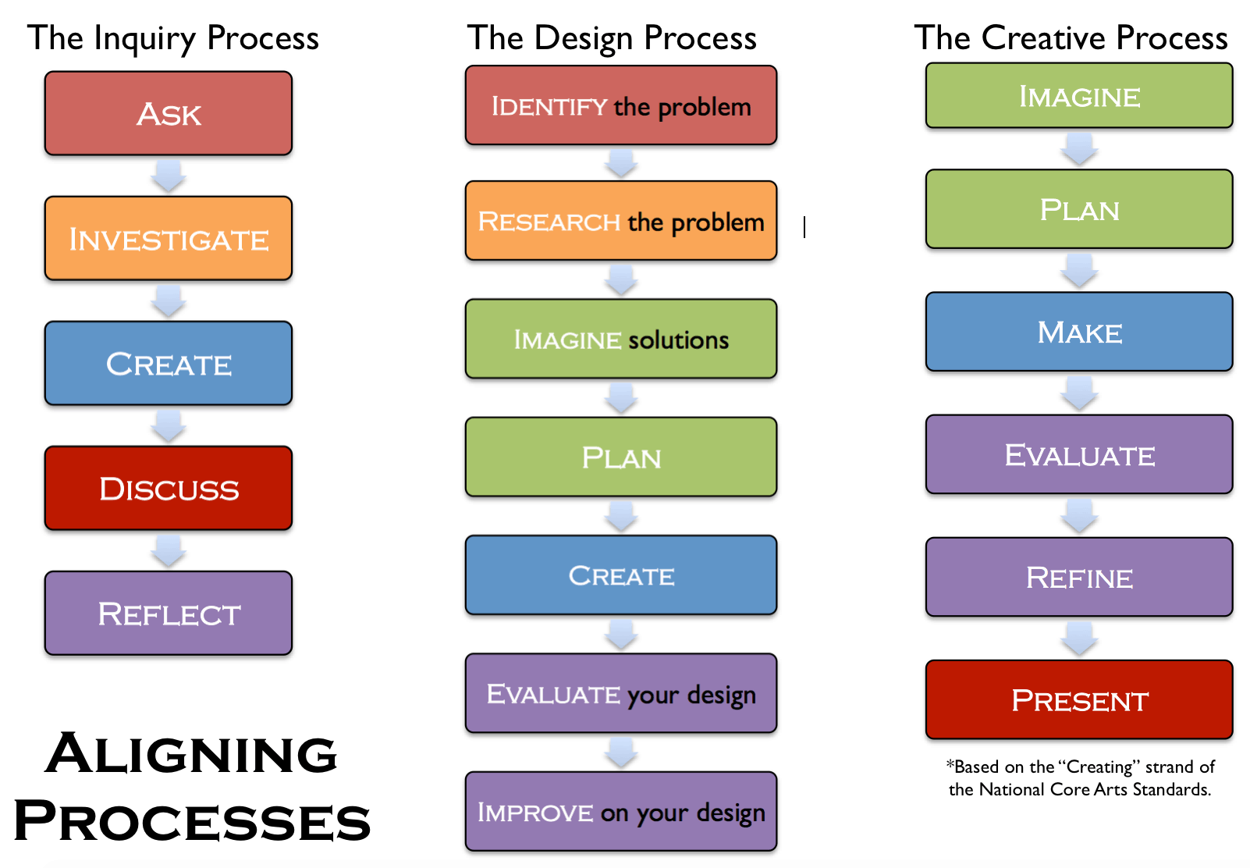

Slide 9
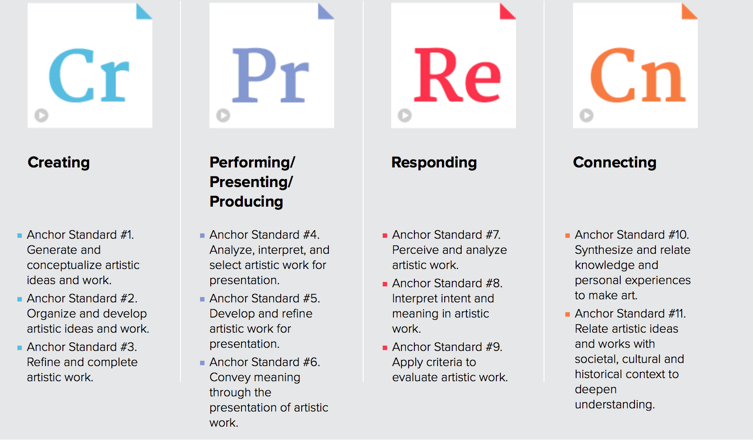

Slide 10
Artistic Process Components
Creating: Conceiving and developing new artistic ideas and work | Performing: Realizing artistic ideas and work through interpretation and presentation. | Responding: Understanding and evaluating how the arts convey meaning | Connecting: Relating artistic ideas and work with personal meaning and external context.
IMAGINE | SELECT | SELECT | SYNTHESIZE
PLAN | ANALYZE | ANALYZE | RELATE
MAKE | INTERPRET | INTERPRET
EVALUATE | REHEARSE | EVALUATE
REFINE | PRESENT
PRESENT

Slide 11
Enduring Understandings and Essential Questions Focusing on the Big Ideas
Enduring understandings are statements that summarize important ideas and core processes…having lasting value beyond the classroom. They synthesize what students should come to understand as a result of studing a particular content area.
Enduring understandings should enable students to make connections to other disciplines beyond the arts.
A true grasp of an enduring understanding is demonstrated by a student’s abilty to explain, interpret, analyze, apply and evaluate it core elements.
Essential questions are “questions that are not answerable with finality in a brief sentence...” and their aim is to “stimulate thought, to provoke inquiry, and to spark more questions – not just pat answers.”
Essential questions also guide student’s as they uncover enduring understandings.

Slide 12
Model Cornerstone Assessments We assess what is important.
Included in the standards are model assessments, that share the following characteristics:
Are curriculum embedded (as opposed to be externally imposed)
Recur over the grades, (becoming increasingly sophisticated over time)
Are done in an authentic context
Assess understanding and transfer (via genuine performance)
Integrate 21st Century Skills (e.g. critical thinking, teamwork) with music content
Evaluate using well developed rubrics
Engage students in authentic and meaningful learning

Slide 13
Looking at the Standards and the Grade Level Benchmarks and Adapting them for Use at Your School
Most likely, you already do a lot of what is expected and described in the new standards, so don’t feel like you have to create a whole new curriculum. (JD Ex.)
Consider taking your existing curriculum documents and doing an “honest” alignment with the new standards, then going back an filling in the gaps and identifying any curricular deficiencies.
Give some serious thought to incorporating the enduring understandings and essential questions, or creating EQ’s for your particular lessons. These questions are a guide for you and should be posed to your students to stimulate discussion and understanding. They are an excellent way to start a lesson and to bring closure to a lesson or activity.
Start this process in small steps…don’t take on too much at one time. Make it a transformative process. If there is something you can’t address (i.e technology, time constraints, schedule, etc.) seek assistance from your administration or colleagues.

Slide 14
Final Questions and Issues
Thank you for staying late to attend this presentation and for your active participation

