Slide 1
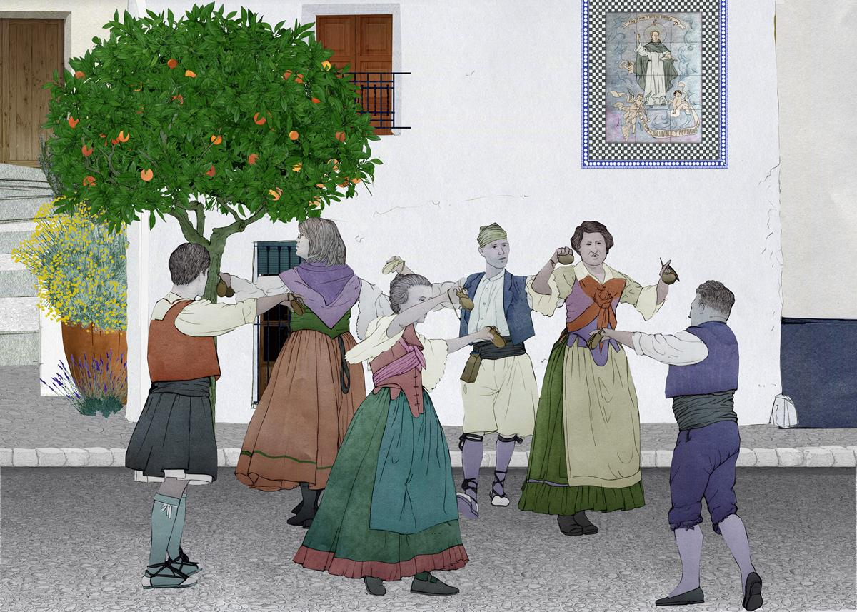
Phyllis Weikart Folk dances
Presented by:
Paul hallsted &
Carla Haynes
2019 NMMEA All-State Conf.

Slide 2
Dances we will experience Today 1/10/19 NMMEA 2019
Le Saluts
Limbo rock
D’Hammerschmiedsg’selln
Haya Ze Basabed
Fjaskern
Kendime
Sliding
Joe Clark Mixer
Notes:
DO NOT ADVANCE to NEXT slide – Carla just teaches dance
Carla:
Please listen - Say – “Let me show you first” – I do, they Say – All say & do – All Think & do
Dance
THEN advance and Show BOXES

Slide 3
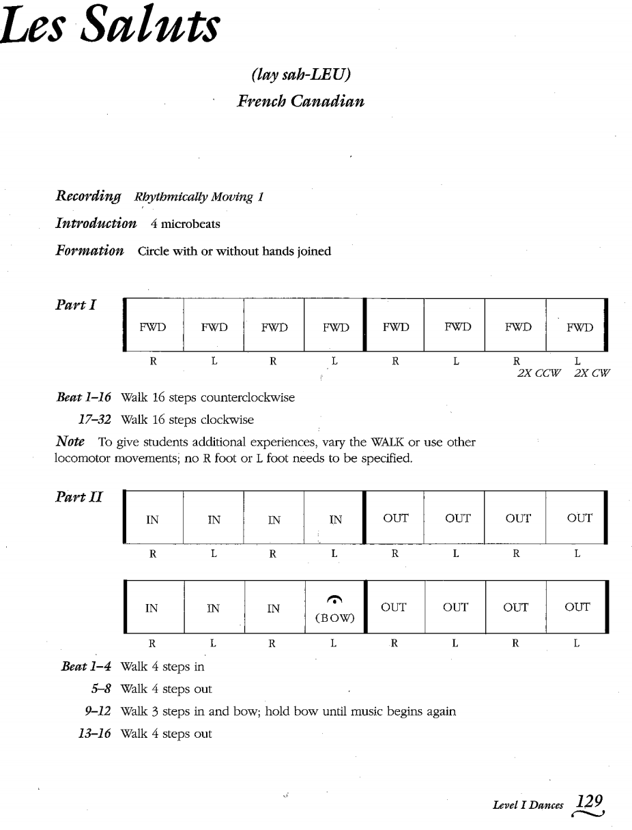
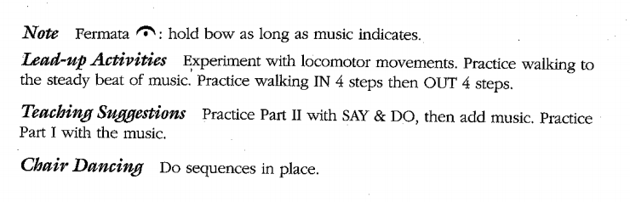
Les Saluts
Notes:
Carla: - Just explain lay out of WHOLE (no details about boxes)
Advance to Next slide: PAUL starts by looking at boxes

Slide 4
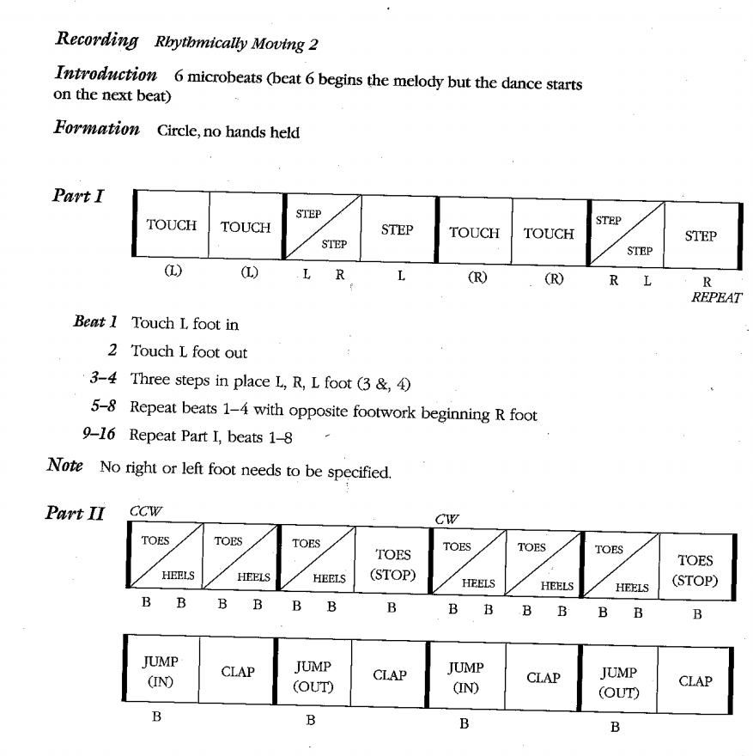
Limbo rock
Notes:
Paul – Explain boxes – Teach Dance
Advance to Next slide – Carla explains

Slide 5
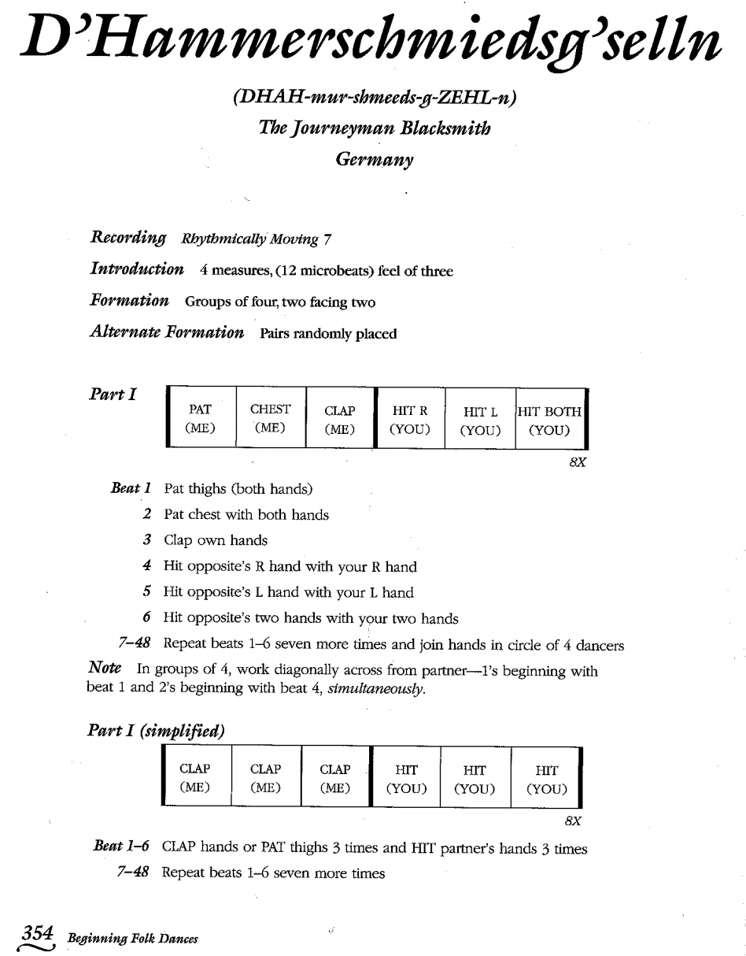
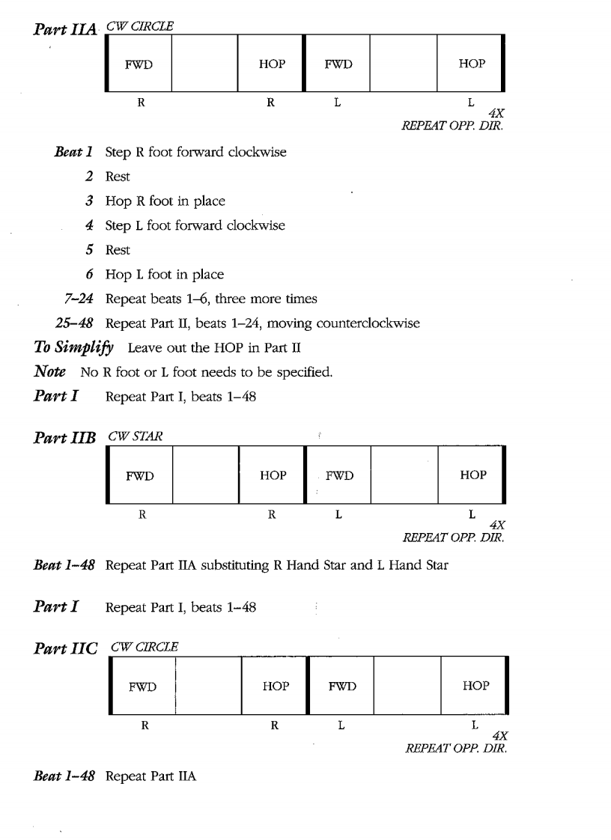
Notes:
Carla Shows there is a Part 1 and Simplified – Part 2 A, 2 B, & 2 C – JUST show
Advance & preview next slide

Slide 6
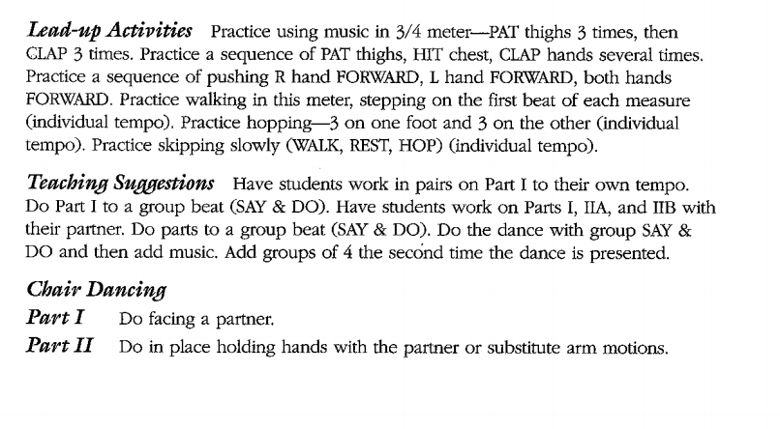
Notes:
Carla discusses the Lead-up Activities Activism & Teaching Suggestions
Teach the way the Suggestions say – switching back and forth from this slide to previous -

Slide 7
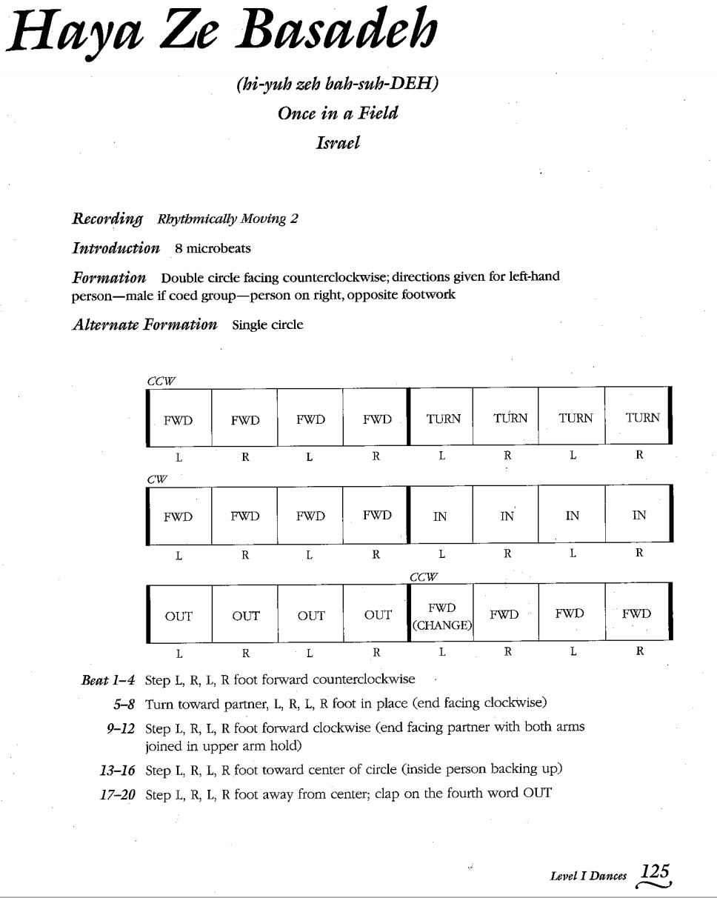
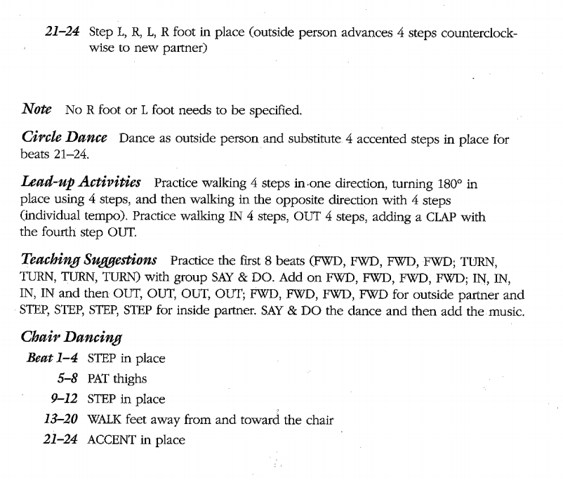
Haya ze basadeh
Notes:
Paul – Review Layout quickly
Advance to Next slide – Paul explains

Slide 8
Notes:
Paul reads Lead-Up Activities & Teaches using the Teaching Suggestions
(Carla helps with switching back and forth between the last slide & this one)

Slide 9
PUT INTO PRACTICE
You will be handed a dance - Look it over
Find the people who have your same dance & find a spot in the room as a group
Your Groups Task using the next
10 min.:
To Discuss & Create a way to Teach the other groups your dance using
Say,
Say & Do,
Think & Do
(use teaching suggestions)

Slide 10
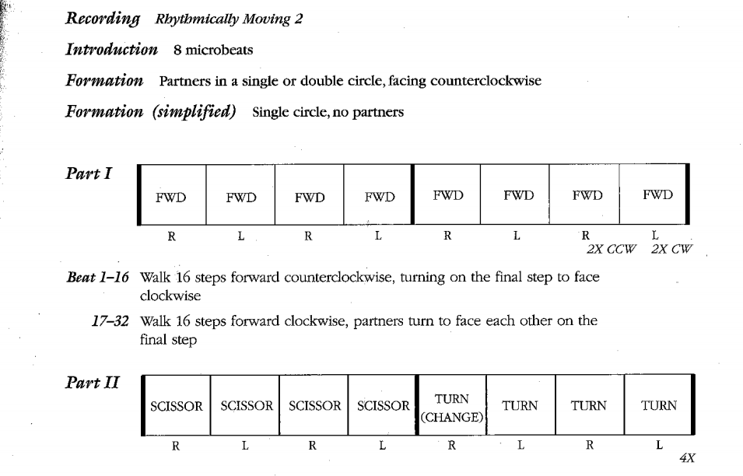
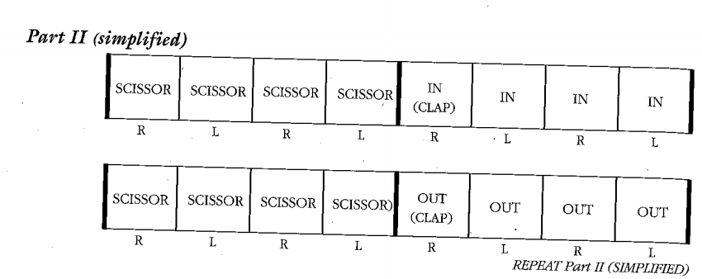
Fjaskern – a Dance from Sweden
Notes:
Just show Title – Let group Teach – then click to display the dance to all

Slide 11
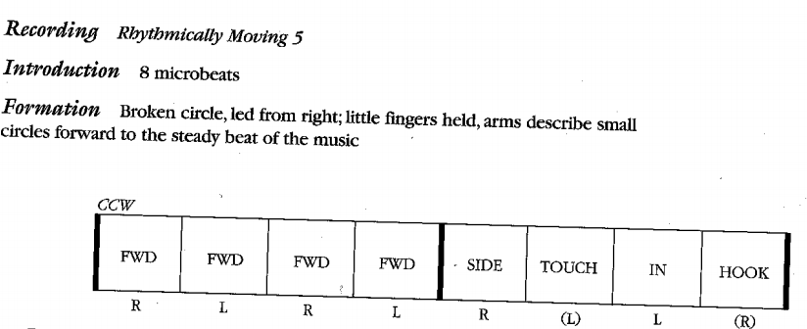
Kendime – a Dance from turkey
Notes:
Just show title – then after dance is done, then click to show instructions

Slide 12
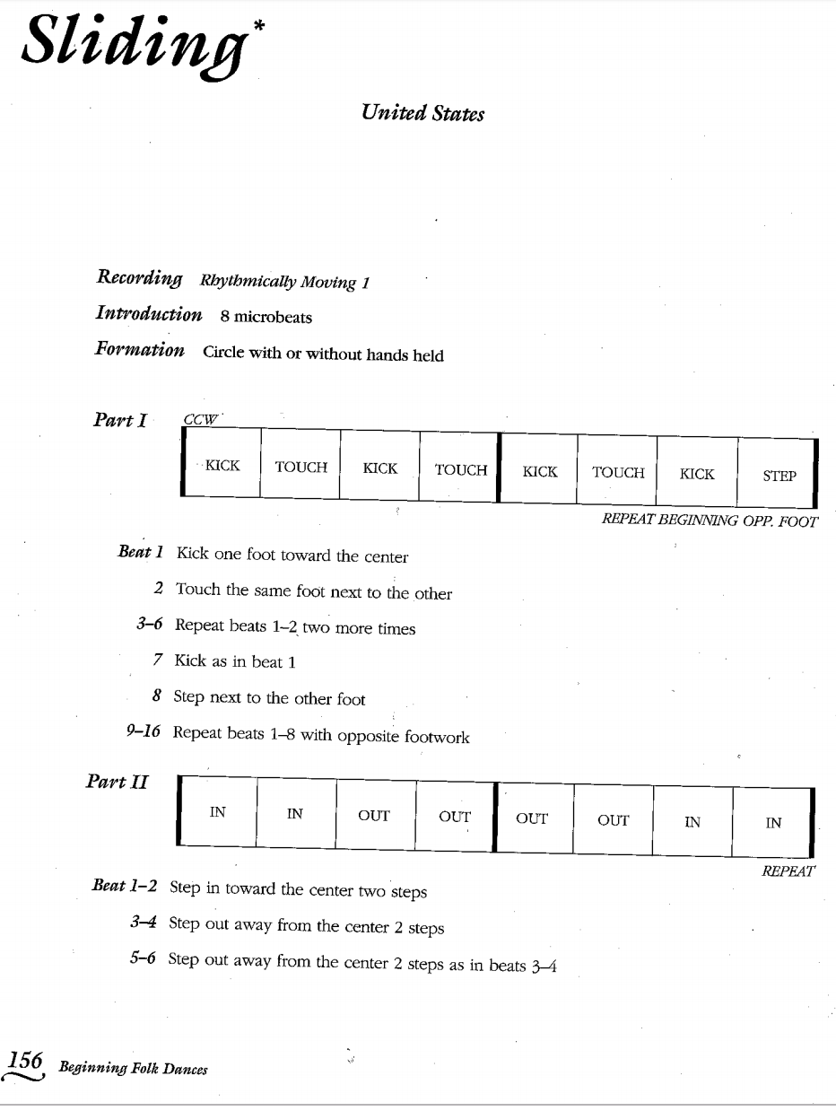
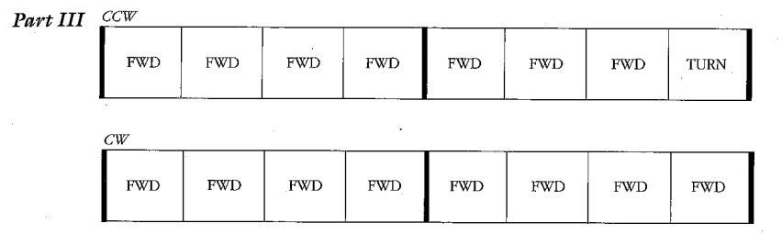
sliding – a Dance from the United States
Notes:
Just show title – after dance is taught & done – then click to show boxes
“NOW we will finish up with a mixer dance” click to show title only!

Slide 13
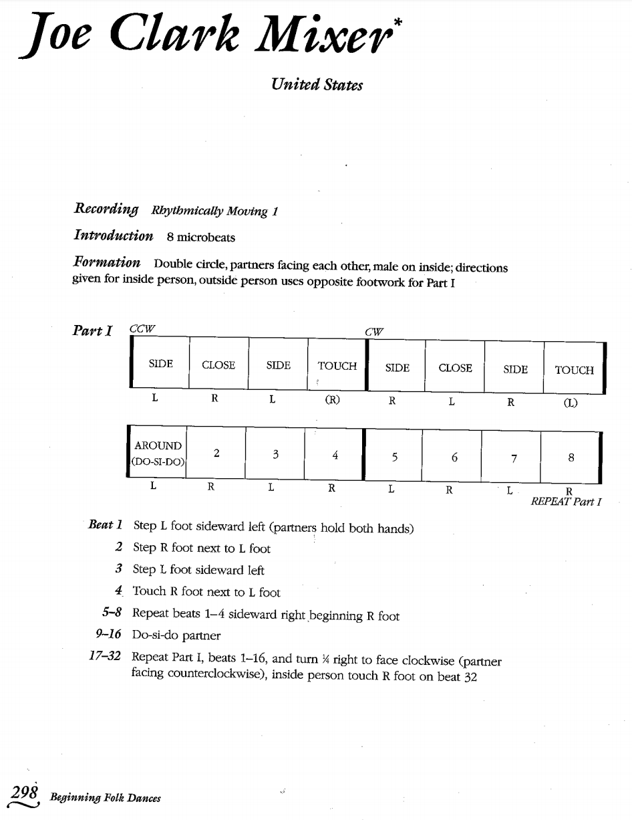
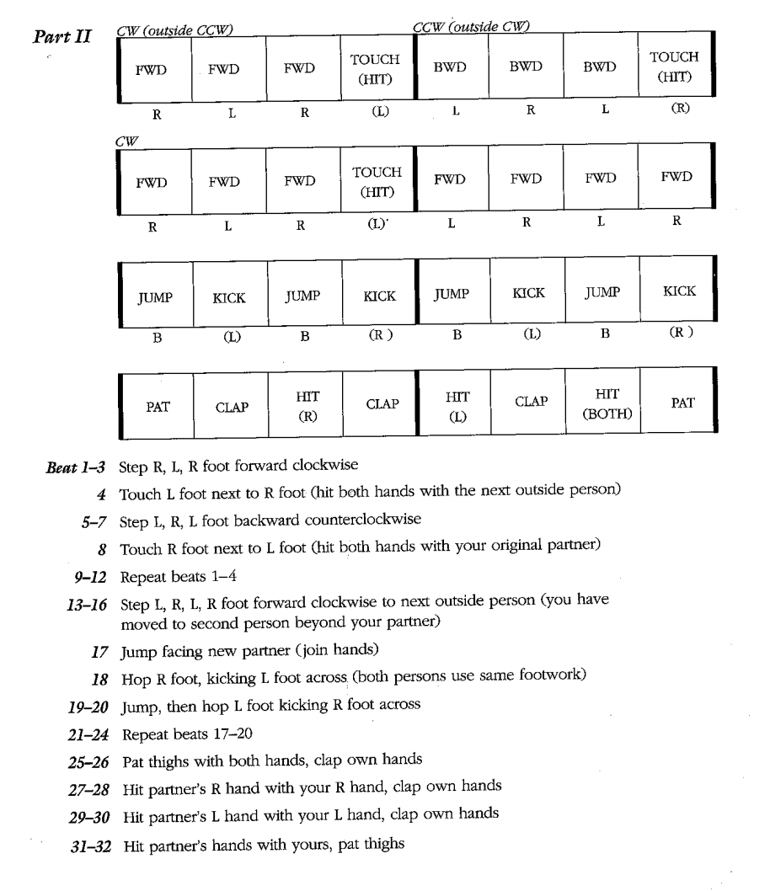
And for lasT... Joe clark mixer
THANK YOU
For attending

